Slide 1
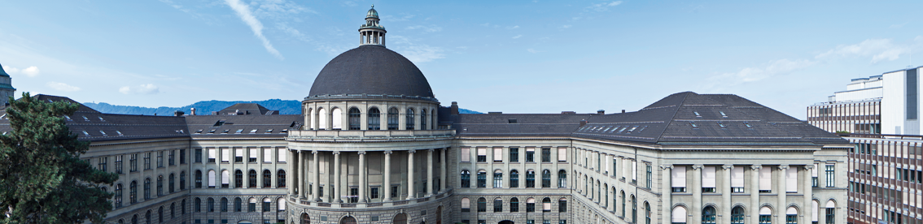
Neural Style Transfer for US imaging
Results of segmentation loss and average style
Davide Menini

Slide 2
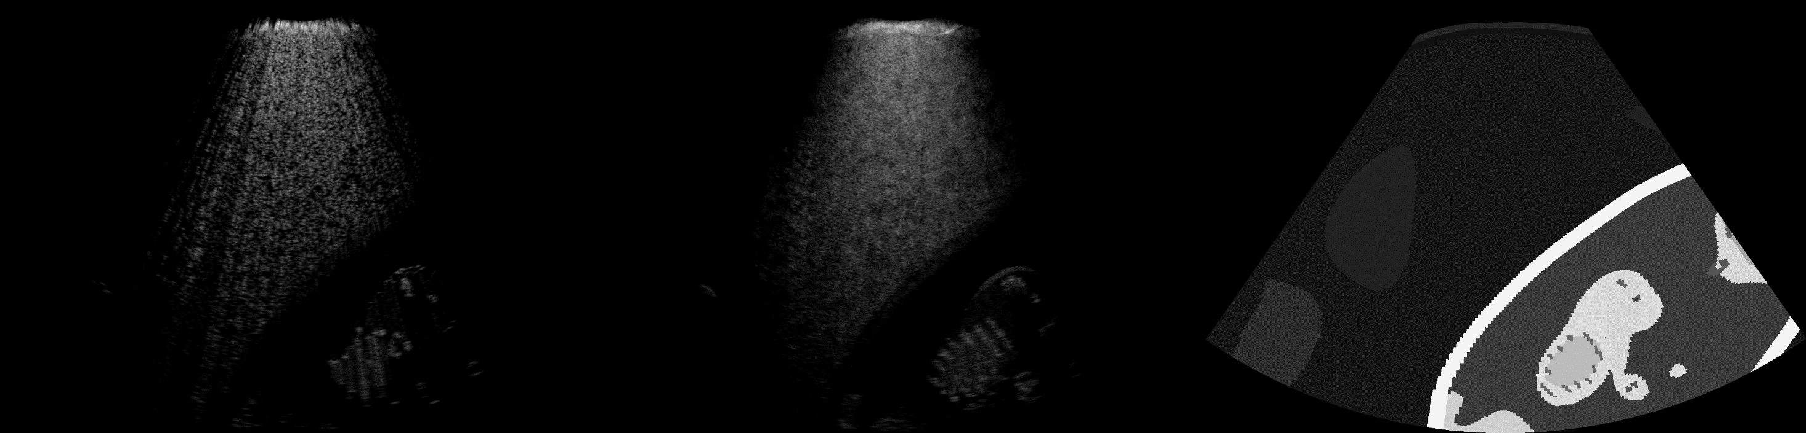
Image 1.png
Content
Style
Segmentation

Slide 3
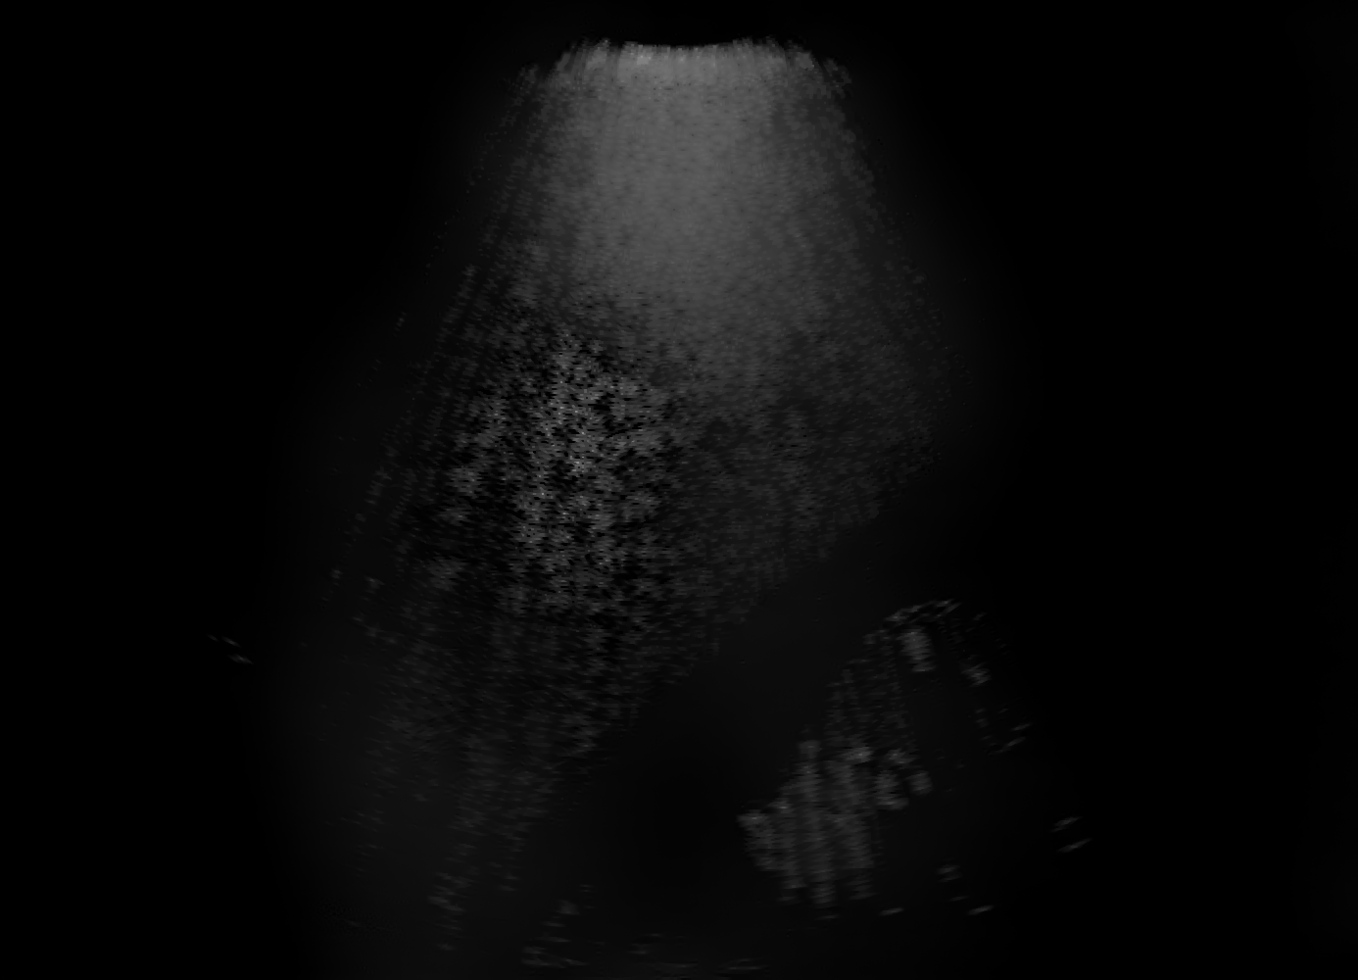
Basic NST
Best MSE = 112
Epoch = 17/25
Runtime = 460 s/ep (CPU)
Style weight = 1e-2
Content weight = 1e4
Total variation weight = 30

Slide 4
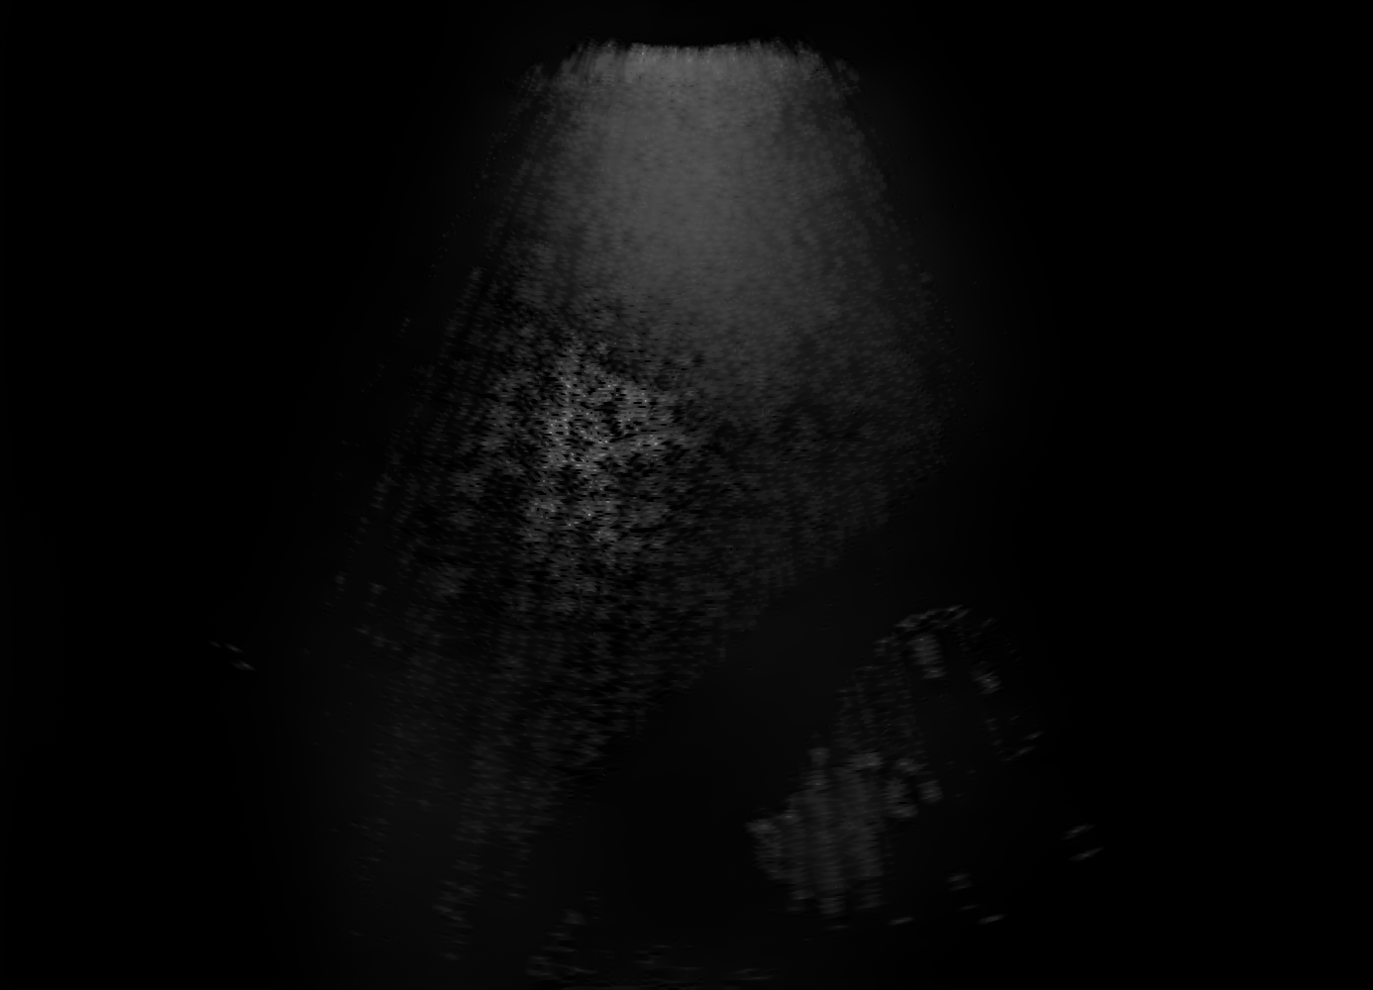
Average style (over ~70 images)
Best MSE = 112
Epoch = 13/25
Runtime = 460 s/ep
Style weight = 1e-2
Content weight = 1e4
Total variation weight = 30

Slide 5
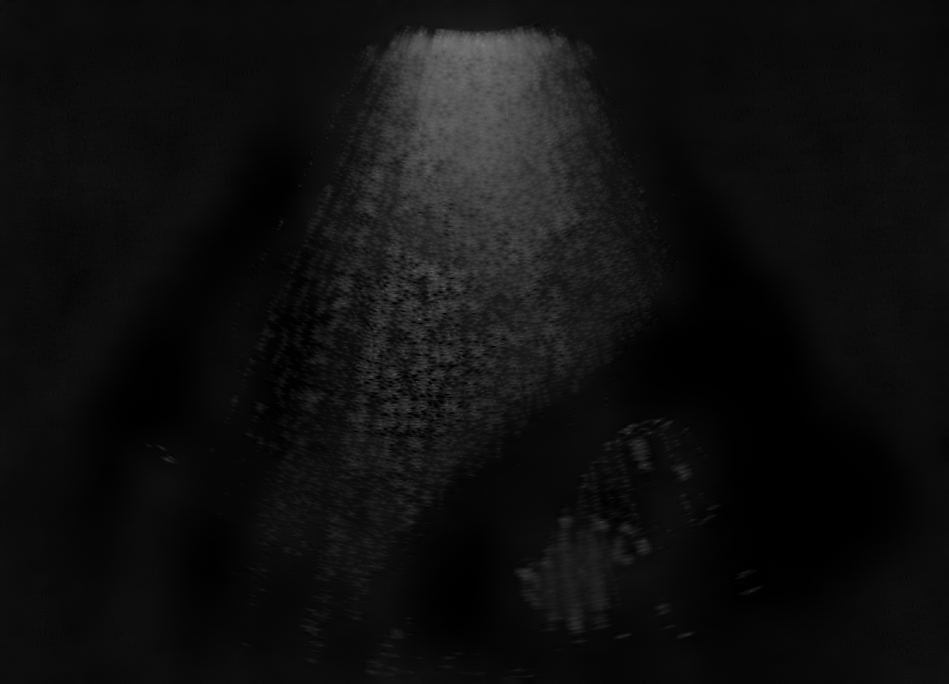
Segmentation loss (all masks)
Best MSE = 151
Epoch = 6/25
Runtime = 460 s/ep
Style weight = 1e-2
Content weight = 1e4
Total variation weight = 30

Slide 6
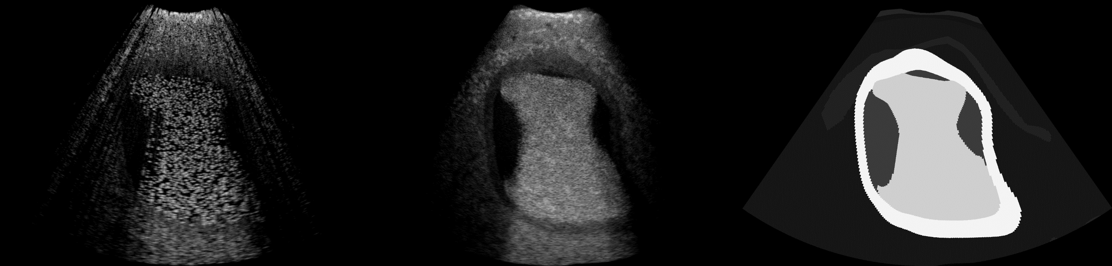
Image 18.png
Content
Style
Segmentation

Slide 7
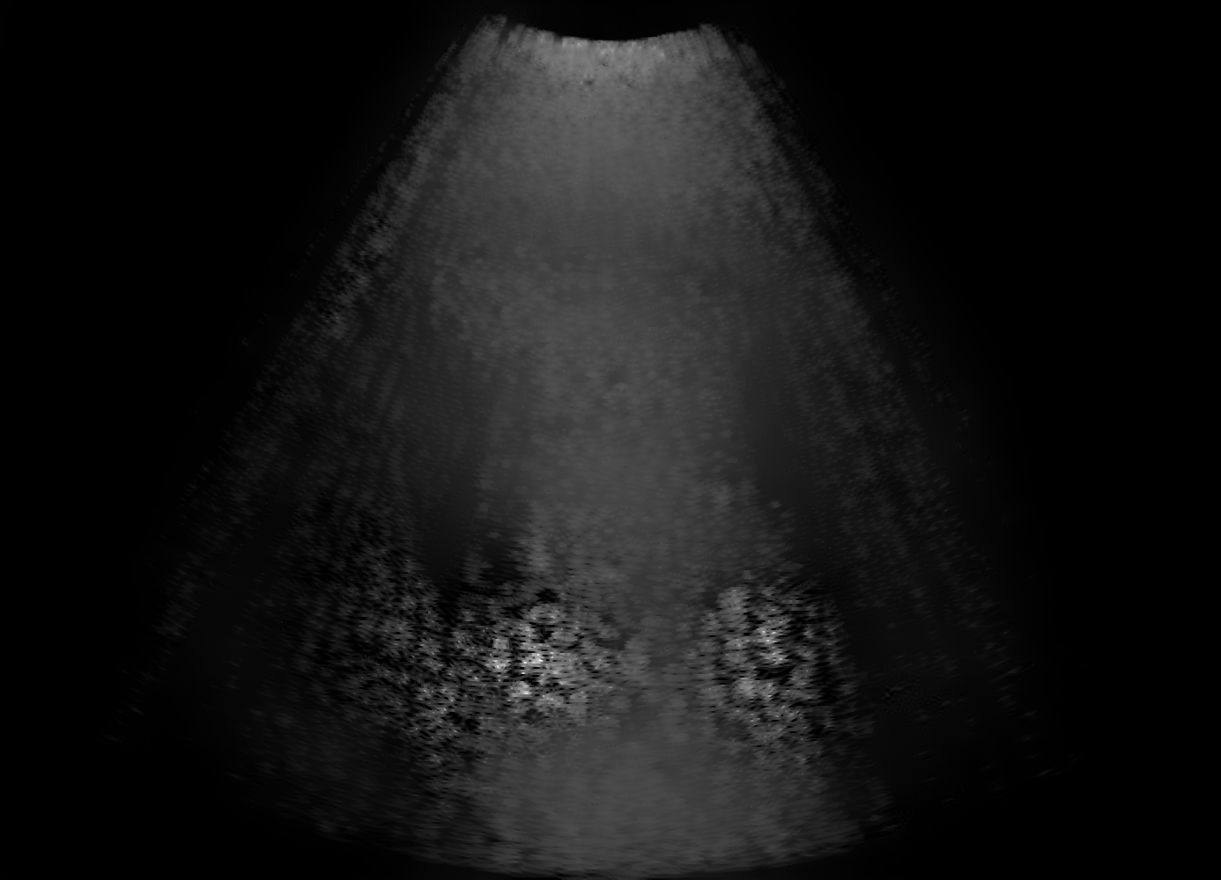
Basic NST
Best MSE = 331
Epoch = 9/25
Runtime = 460 s/ep
Style weight = 1e-2
Content weight = 1e4
Total variation weight = 30

Slide 8
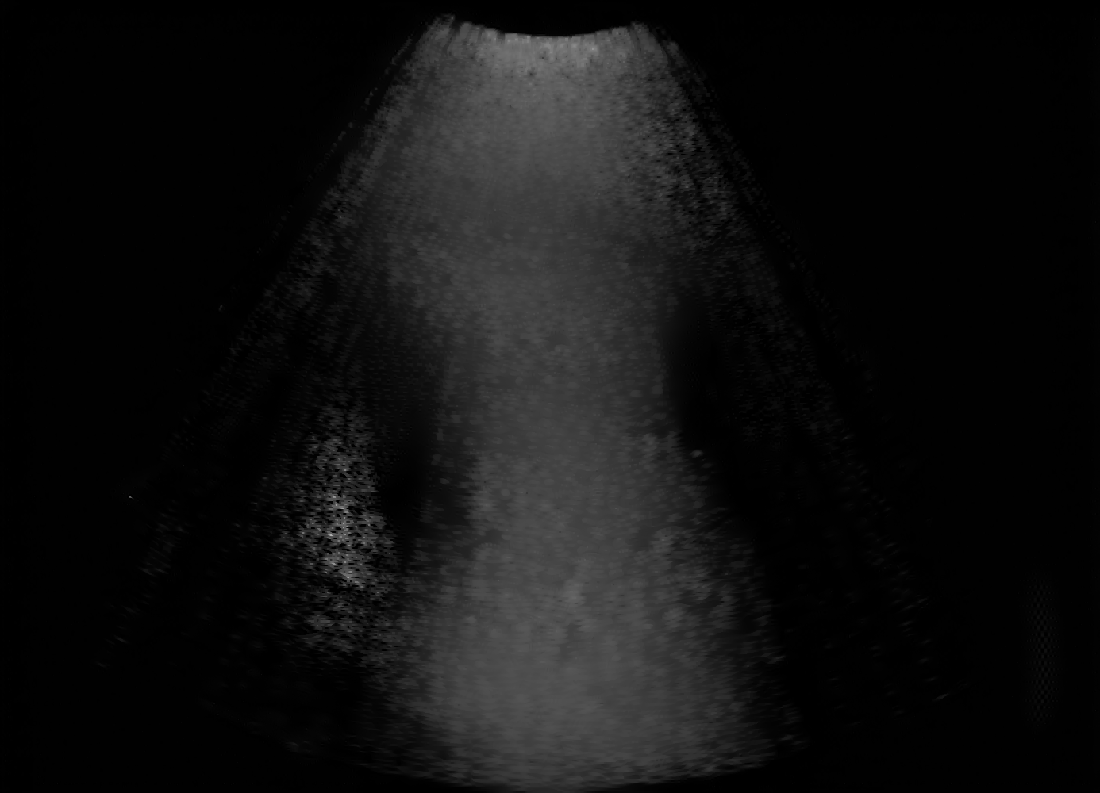
Average style (over ~70 images)
Best MSE = 260
Epoch = 19/25
Runtime = 460 s/ep
Style weight = 1e-2
Content weight = 1e4
Total variation weight = 30

Slide 9
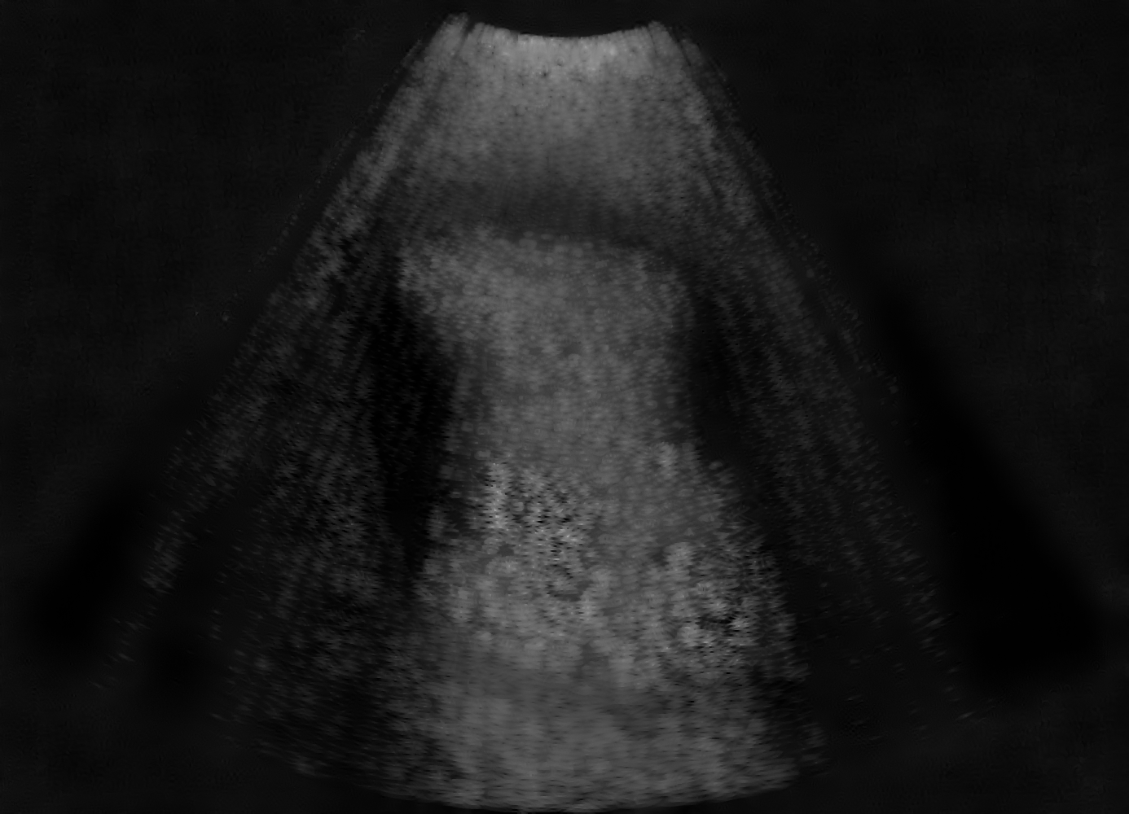
Segmentation loss (all masks)
Best MSE = 353
Epoch = 4/25
Runtime = 460 s/ep
Style weight = 1e-2
Content weight = 1e4
Total variation weight = 30

Slide 10
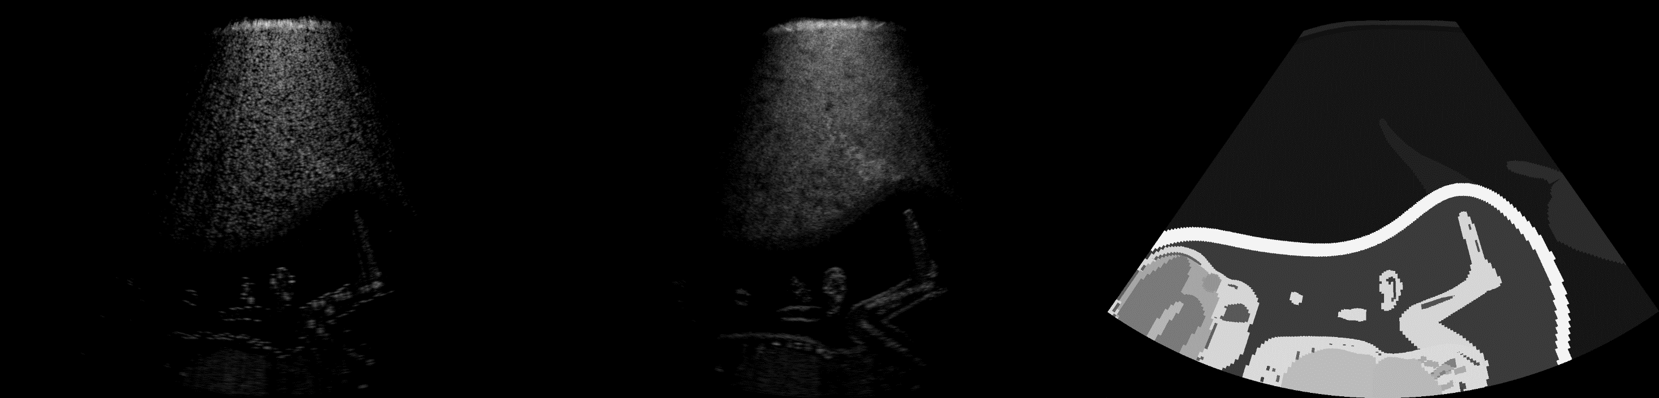
Image 34.png
Content
Style
Transfer

Slide 11
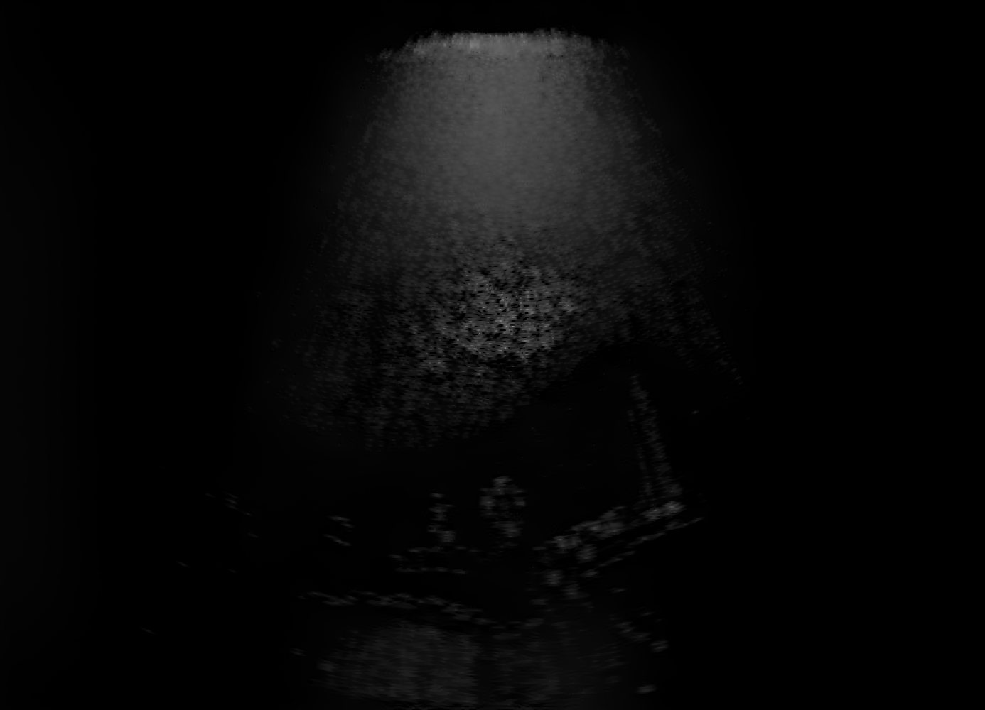
Basic NST
Best MSE = 86
Epoch = 14/25
Runtime = 460 s/ep
Style weight = 1e-2
Content weight = 1e4
Total variation weight = 30

Slide 12
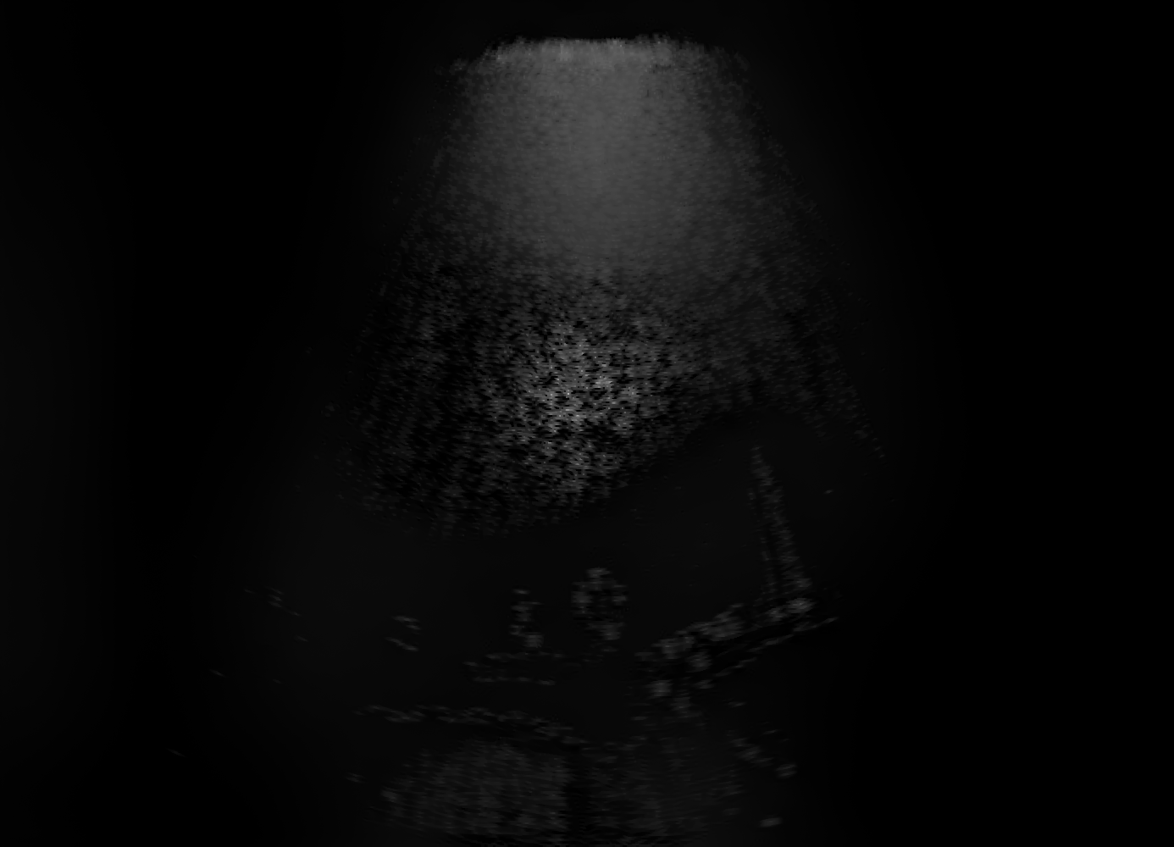
Average style (over ~70 images)
Best MSE = 109
Epoch = 17/25
Runtime = 460 s/ep
Style weight = 1e-2
Content weight = 1e4
Total variation weight = 30

Slide 13
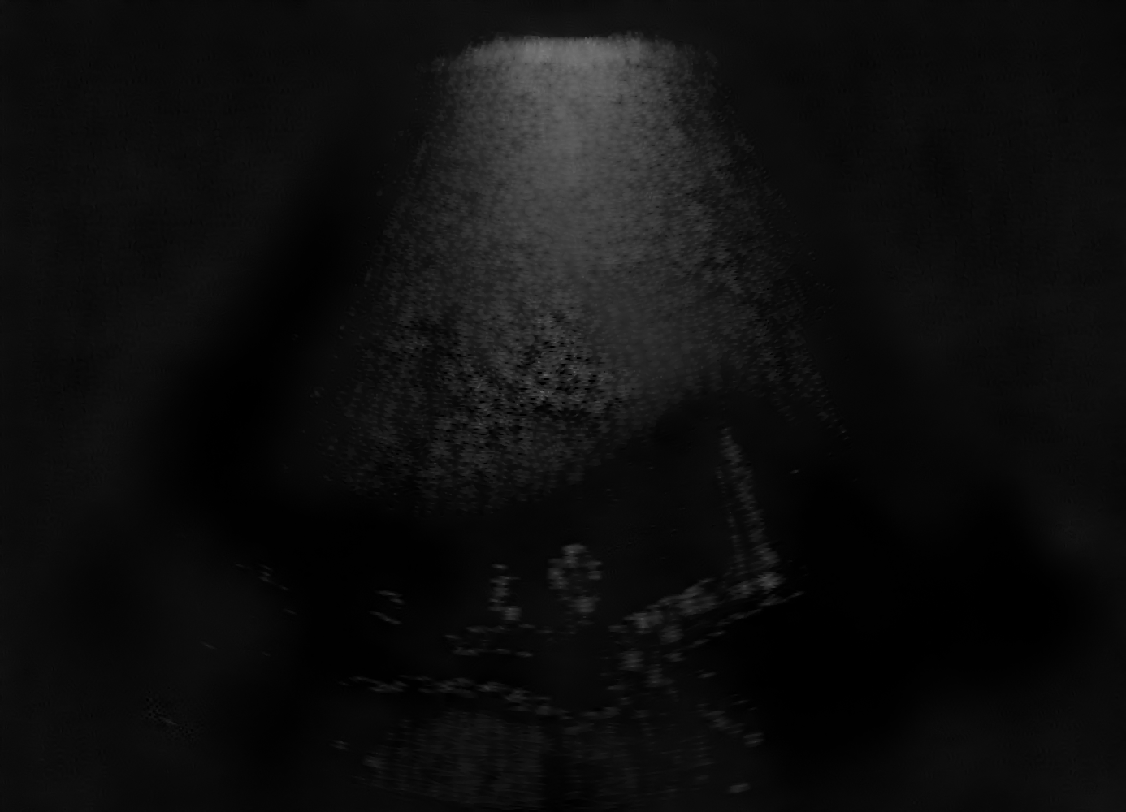
Segmentation loss (all masks)
Best MSE = 151
Epoch = 3/25
Runtime = 460 s/ep
Style weight = 1e-2
Content weight = 1e4
Total variation weight = 30

